Slide 1
FACILITIES & ADMINISTRATIVE (F&A) RATES

Slide 2
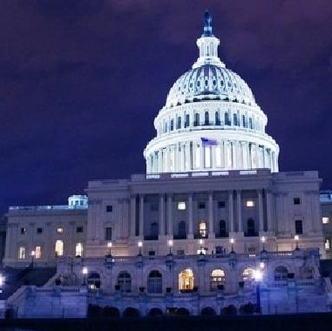
FACILITIES & ADMINISTRATIVE (F&A) RATES
Facilities and Administrative costs, also sometimes referred to as indirect costs, are the overhead costs of the University.
The F&A rate is a cost recovery mechanism designed by the federal government to ensure it bears its fair share of the costs of research.
Office of Cost Analysis (OCA) is responsible for the calculation, submission and negotiation of F&A rates with the Department of Health and Human Services (DHHS).
F&A costs represent a recovery of costs already incurred by the institution.

Slide 3
FACILITIES & ADMINISTRATIVE (F&A) RATES
All sponsored projects include two types of costs: those that are directly attributed to the project and those that are incurred indirectly for campus/departmental support and facilities management.
Direct Costs can be readily and specifically identified with a particular sponsored project, instructional activity, or any other institutional activity.
Examples of direct costs include salaries and wages, fringe benefits, consumables, purchased services, travel and certain equipment.
Indirect Costs are incurred for common or joint objectives and cannot be readily or specifically identified with a project or activity.
Examples of indirect costs include administrative salaries, office expenses, utilities, and other facilities costs including depreciation.

Slide 4
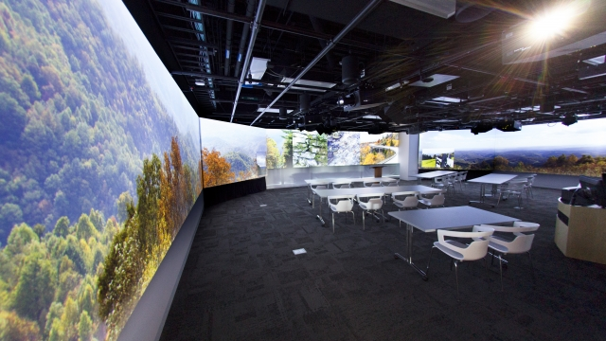
FACILITIES & ADMINISTRATIVE (F&A) RATES
The Facilities components of indirect costs account for more than half of our current F&A rate for research.
Facilities costs are allocated to Research, Instruction, Other Sponsored Activities and Other Institutional Activities based on a space study.
We survey the top 30 research departments, which account for almost 90% of the University’s research dollars spent.
Accuracy and consistency of the space coding is critical.

Slide 5
FACILITIES & ADMINISTRATIVE (F&A) RATES
The Administrative components of indirect costs are capped at 26% by the Federal Government (since 1991).
We are still required to calculate our actual Administrative costs.
Compliance and other regulatory costs continue to grow, but cannot be recovered on sponsored projects due to the cap.
Examples include central functions such as President’s Office, HR, Finance, OVPR as well as departments administration, including deans’ offices.

Slide 6
THE F&A RATE CALCULATION PROCESS
Audited Financial Statements
Total Costs
MTDC Exclusions:
Scholarships/Fellowships
Capital Expenses
Sub-agreements >$25K
Fringe blended vs Actual Accounts
F&A Cost Pools:
Depreciation
Operations and Maintenance
Interest Expense
General Administration
Departmental Administration
Sponsored Program Admin.
Library
Adjustments and Transfers
Review for Unallowable Expenses
Direct Cost Bases:
Instruction and Dept. Research
Organized Research
Other Sponsored Activities
Assign Expenses to F&A Pools and Direct Bases
Allocations
Notes:
Adjustments to the Financial Statements are based on rules and guidelines set forth in the OMB’s Uniform Guidance.

Slide 7
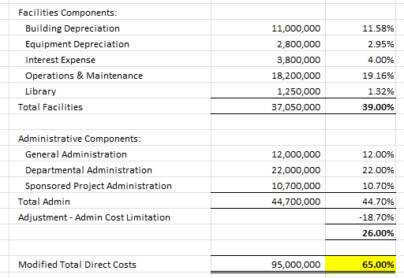
FACILITIES & ADMINISTRATIVE (F&A) RATES
Let’s look at an example. Refer to below assumptions:
Total Facilities costs attributed to research = $37,050,000
Facilities costs/MTDC = Facilities rate of 39%
Assignable university square feet = 8,000,000
Space coded to research = 6% or 480,000 sq. ft.
Modified Total Direct Costs (MTDC) = $95,000,000
Total Administrative MTDC = $100,000,000
Total Admin/MTDC = Admin rate of 44.70%
Calculated F&A rate with Admin cap = 65%

Slide 8
FACILITIES & ADMINISTRATIVE (F&A) RATES
SUMMARY: OBTAINING AN F&A RATE AGREEMENT
Space Survey
Treatment of Costs
Calculation and Submission of Rate
Federal Review and Negotiation
Functional space survey (determine Organized Research (OR ) sq. ft.).
Typically starts during spring of base year. For example, since our base year is FY22, we started our space survey April 2022.
Identify F&A, direct and unallowable costs.
Ensure consistent treatment of costs.
Ensure that costs are allowable and allocable.
Must comply with OMB’s Uniform Guidance.
Requires Audited Financial Statements, which we typically complete by December after end of the fiscal year.
Prepare standard submission documents and supporting schedules.
Rates are submitted at the end of the following fiscal year as it takes time to summarize all costs and adjustments, including finalizing space survey results.
Cognizant agency (DHHS) reviews the F&A rate calculation and identify disallowances based on interpretation of Federal guidelines.
On-site space survey review including interviews of Principal Investigators (PI).
Negotiate final F&A rate.
Federal Review estimated to be conducted in the spring of 2024 for base year 2022.
Final negotiated rate effective 7/1/24.

Slide 9
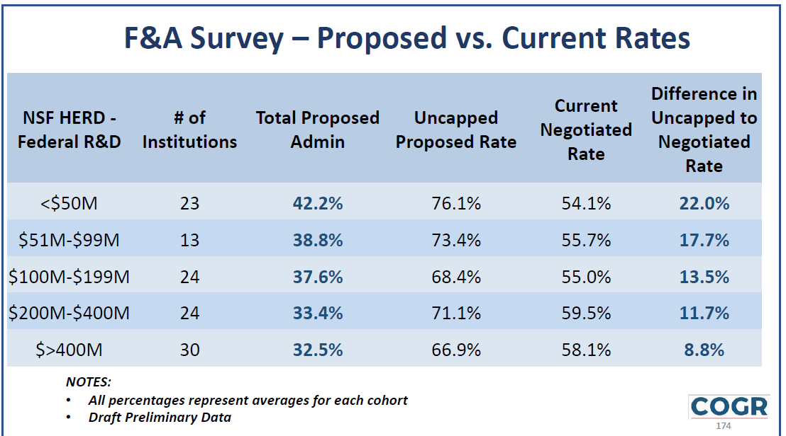
FACILITIES & ADMINISTRATIVE (F&A) RATES
Cognizant agencies (for UConn, DHHS) generally negotiate lower rates than university proposed rates despite applying consistent federal costing principles. Please see below result of F&A survey conducted by Council on Government Relations (COGR).
Negotiated rates are usually lower as DHHS may deem research percentages in labs to be lower than what was indicated by PI’s during the space survey. DHHS determines this through their site visits during the audit phase. Any discrepancy is extrapolated to the whole population resulting in a lower overall research (F&A) rate.
We may also negotiate a lower rate than what was calculated and proposed to make grant proposals by PI’s more competitive.
Notes:
Negotiated rates are usually lower as HHS may deem research percentages in labs to be lower than what was indicated by PI’s during the space survey. DHHS determines this through their site visits during the audit phase. Any discrepancy is extrapolated to the whole population resulting in a lower overall research (F&A) rate.
We can also prefer to negotiate a lower rate that what was calculated and proposed to make grant proposals by PI’s more competitive.

